Slide 1
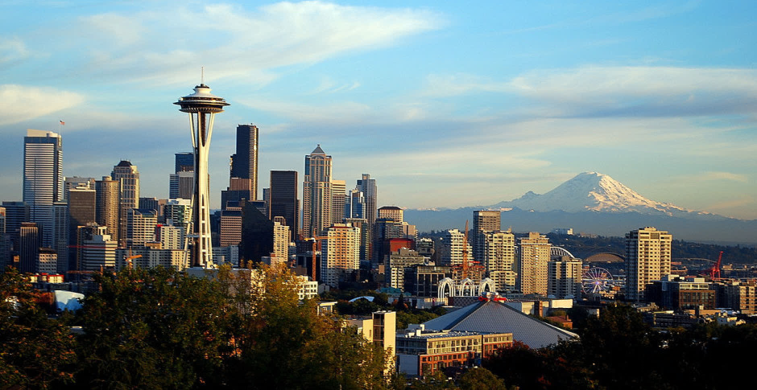
Electric Cars of Washington State
POOR6 – Riccardo Gobbo, Simone Merlo, Diego Spinosa

Slide 2
Outline
01
02
Domain & Data Sources
Ontology
Domain, goals and data sources
Domain model
03
04
Queries & Data Analysis
Future Work
Queries, heatmaps and graphs
Future work & possible expansion

Slide 3
01 Domain & Data Sources

Slide 4
Domain
Electric Cars
ZIP Codes
Plug-In and Battery cars registered in the state of Washington
ZIP Codes and related cities and counties
Adjusted Gross Income
Charging Stations
Adjusted Gross Income (AGI) for each ZIP Code
Private and Public Stations to recharge electric vehicles

Slide 5
Goal
The goal of our work is to provide a knowledge graph to evaluate the electric vehicles accessibility by highlighting the correlation between:
The electric cars
The charging stations
The average income
of the people living in the state of Washington, focusing on the different territorial divisions.

Slide 6



Data Sources
Electric Cars
AGI
Charging Station
Plug-In and Electric (BEV) cars
2 possible sources:
Kaggle
wa.data.gov
Adjusted Gross Income for each ZIP Code
Data about Public and Private station to charge electric vehicles

Slide 7
02 Ontology

Slide 8
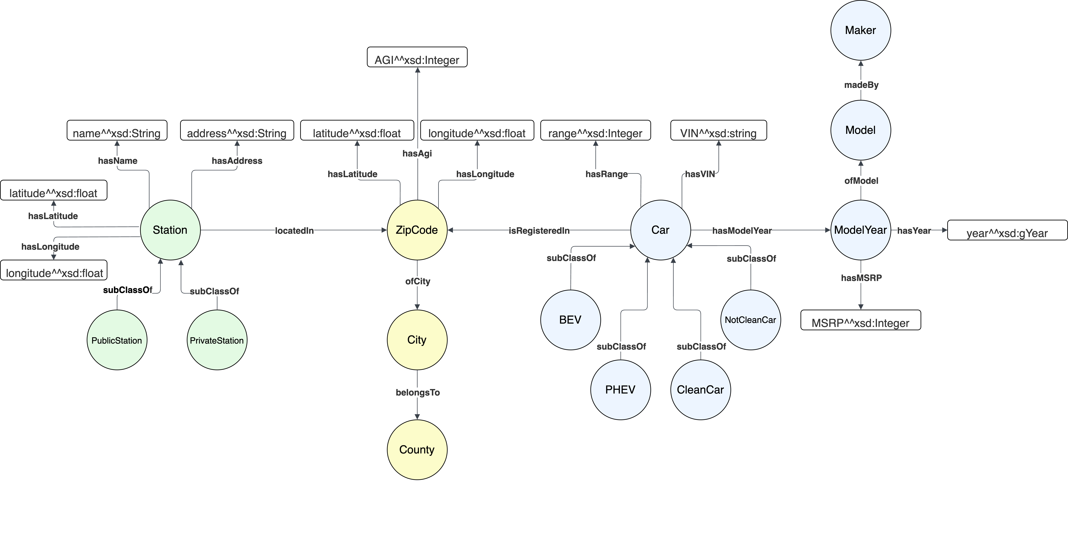
Ontology

Slide 9
03 Queries & Data Analysis

Slide 10
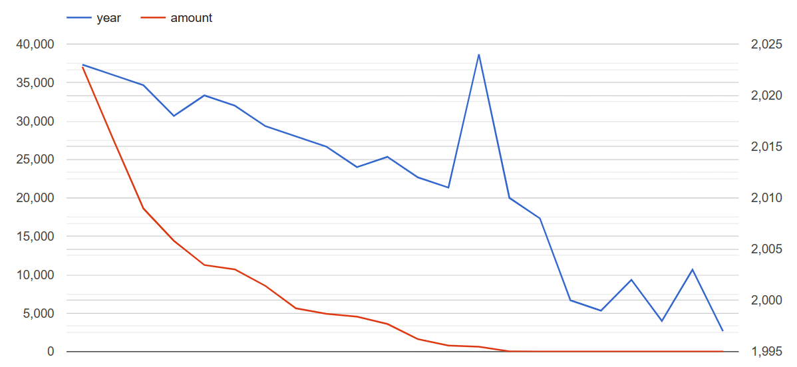
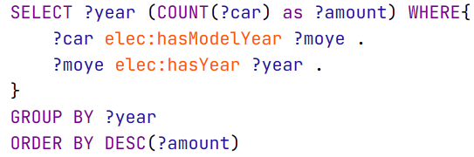
1. Query 2
How many EV cars are registered for each production year?
Indicator of EV adoption through time.
Notes:
DIEGO

Slide 11
2. Query 4
What is the mean AGI and charging stations amount/type for each city?
Highlights the eventual correlation between wealth and charging station density/type
Notes:
GOBBO

Slide 12
3. Query 5
What is the car count and the charging station count for each county?
Highlights the eventual correlation between car density and charging station density
Notes:
GOBBO

Slide 13
4. Query 7
What is the clean and non-clean car count for each production year?
Highlights how the amount of clear and non-clean registered vehicles varied over time and their proportion.
Notes:
DIEGO

Slide 14
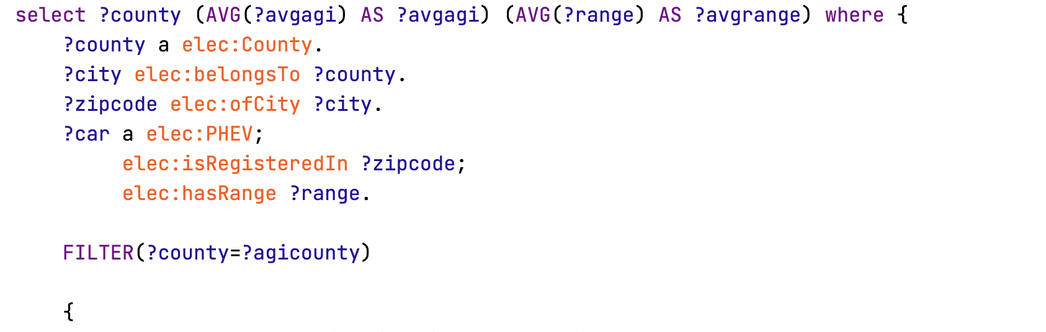
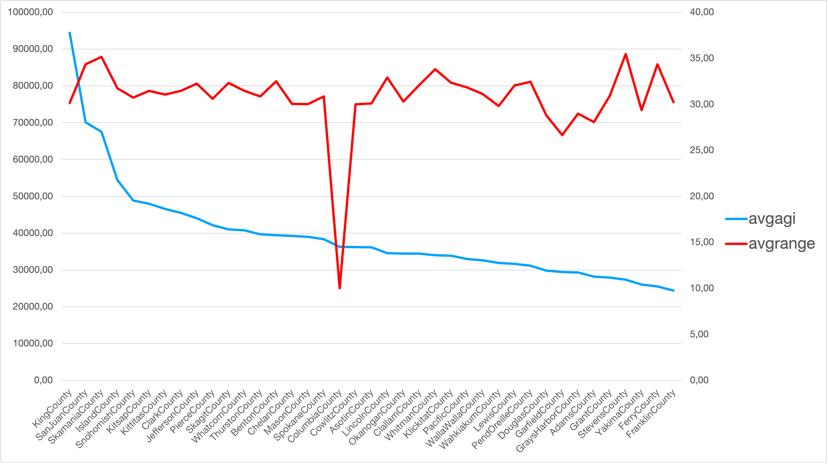
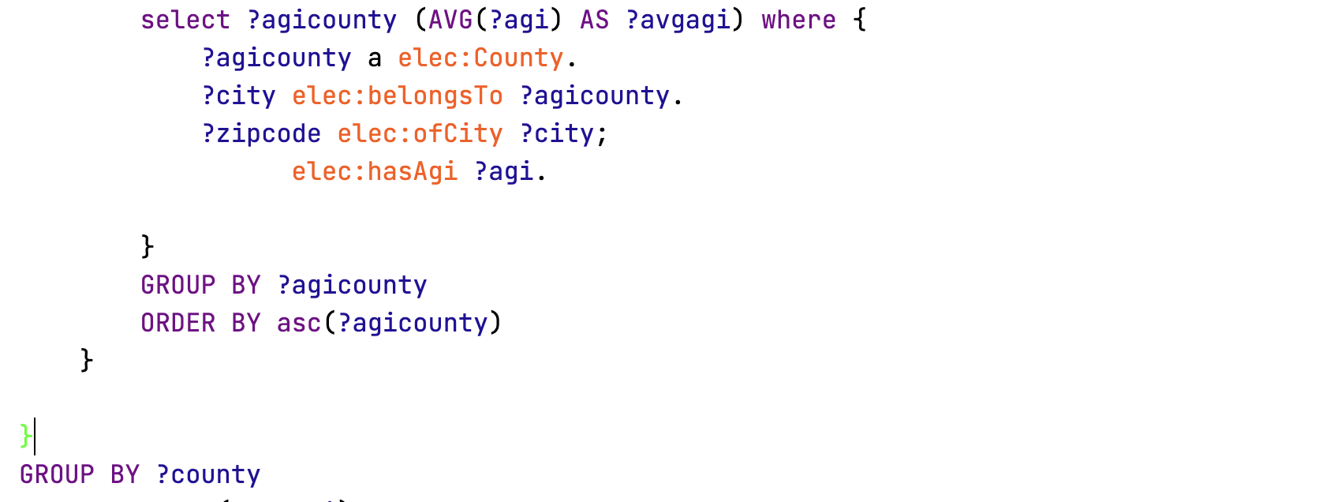

PHEV Cars Range and AGI
What is the average range of PHEV cars and average AGI for each county?
Do, on average, richer regions buy longer-range hybrid vehicles?
Notes:
MERLO

Slide 15
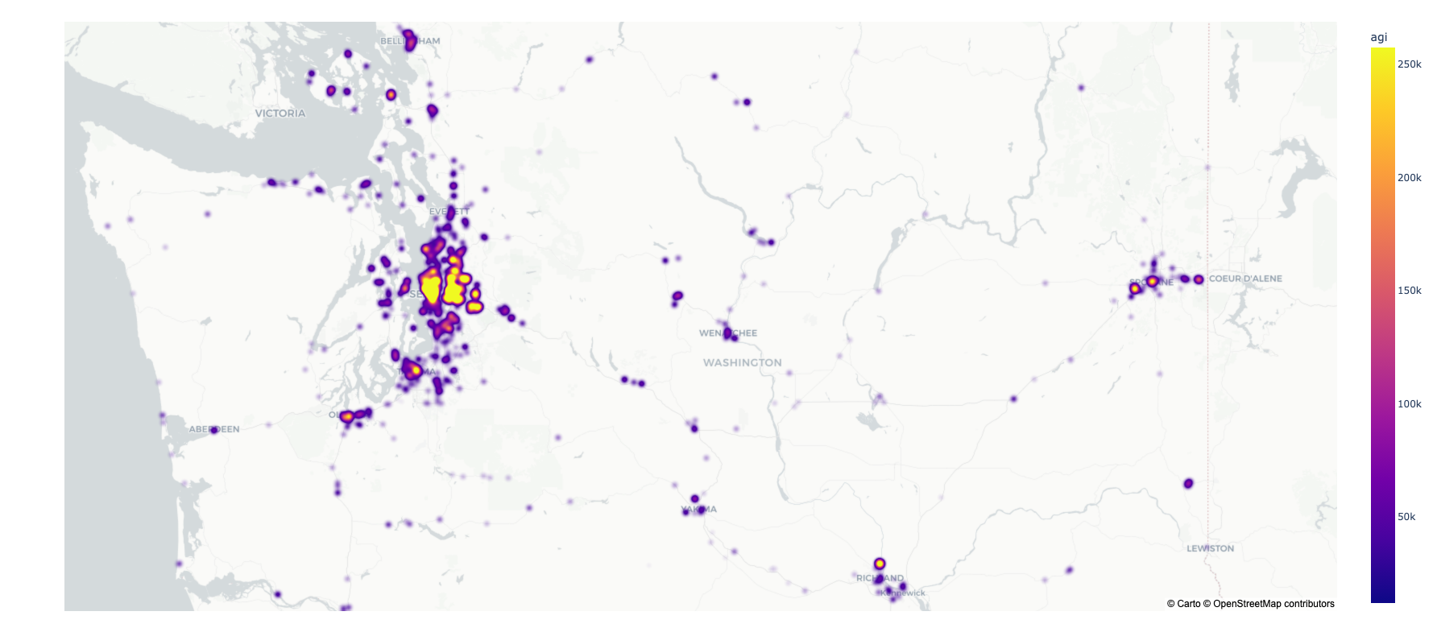
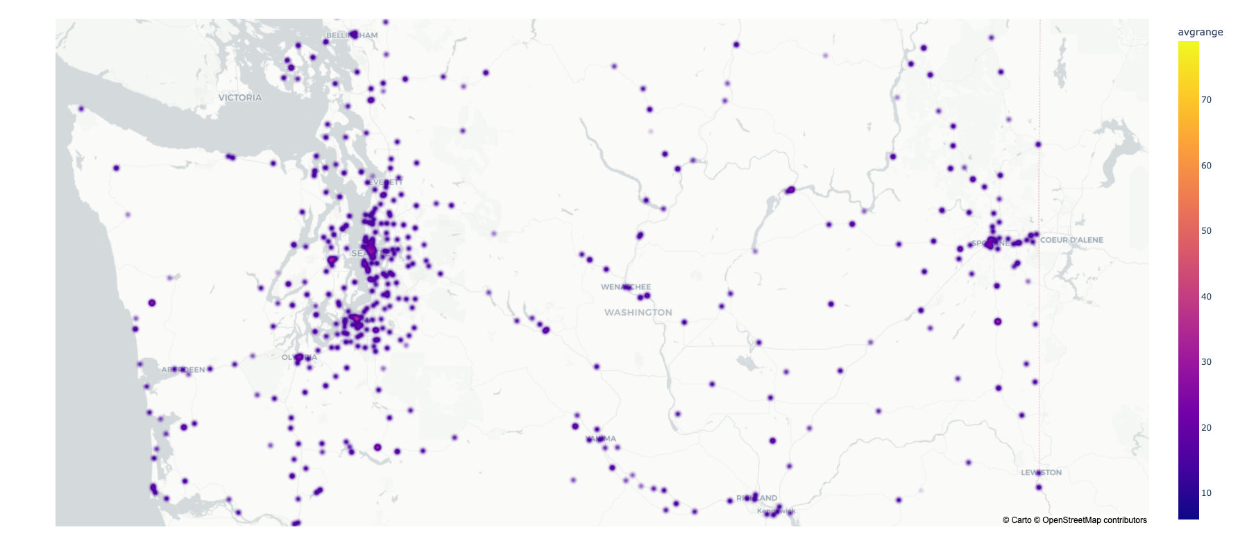
Notes:
MERLO

Slide 16
KG Applications
Car number-wealth correlation
Is income a limit to EV popularity?
Charging station-wealth correlation
Are charging stations evenly installed?
Charging station-Car number correlation
Does charging station density influence EV diffusion, both by limiting or supporting it?

Slide 17
04 Future Work

Slide 18
Future Development & Expansion
Add more US States
Expand to Europe/World
Expand the kg with data from other US states
Challenge due to the ZIP Codes
Range of electric cars
Add power suppliers
Range of electric cars is not maintained since they are considered all clean
Need a data source to merge cars and stations power suppliers

Slide 19
Thanks for your attention!

